Slide 1

SMART GRADER
SPRING 2022 CAPSTONE PROJECT | DELIVERABLE-6
GUIDED BY-PROF.HENRY WONG

Slide 2

Team Members
AKANKSHYA BISWAL
EMI HARRY
GIO ABOU JAOUDE
JONATHAN ANGAMARCA
JOSEPH DOUGAL
JOSE SALCEDO
RITHVIK SUBRAMANYA
TJ RABBANI
WAHIDUR RAHMAN

Slide 3

Agenda
Project Recap
Sprint 5 Recap
Sprint 6
Acceptance criteria
Test Cases
Sprint Backlog
Milestone Timeline
Retrospectives
Conclusion
Notes:
Project Description and Project Components
Technologies used in the project
Market Analysis
User personas
Milestone timeline
Retrospective: things that worked

Slide 4

WHAT IS SMART GRADER?

Slide 5
A website that can generate and grade assignments.
Uses NLP to generate and score text-based questions and answers.
Check correlation for text responses between a student answer and a teacher answer to grade that answer.
Allows for different types of accounts like Student,Educator,Others.
Product can be expanded for more user personas, depending on the scope of the project.
Product may also include a paywall for some features.
AKANKSHYA BISWAL

Slide 6

Sprint 5 Recap

Slide 7
​ ​ Task/Story​ | ​ Key​ | ​ Summary​ | ​ Story Points​ | ​ ​ Priority​
​ ​ Story​ | Key-1​0​ | As an educator, I want to get the update on the new features that are added to the Smart Grader application.​ | ​4​ | ​ ​ High​
Task​ | Key-7​ | Created presentation for Sprint 5​ | ​​ | ​ Low​
​ Story​ | ​ Key-8​ | As a student, I want to logout from the application after successfully submitting my homework but was unable to logout.​ | 5​ | ​ High​
Story​ | Key-20​ | As an educator, I want to get a list of all the subjects for which I would be able to create assignments for the students.​ | 8​ | Highest​
Task​ | Key-6​ | Create the burndown chart for last and this semester.​ | ​ | Low​
RITHVIK SUBRAMANYA

Slide 8

Sprint 6

Slide 9
Committed Task and Stories
​ Task/Story​ | Key​ | Summary​ | Story Points​ | ​ Priority​
Story​ | Key-11 | As an educator, I want to navigate to the English tab under the subject's menu. | 8 | Highest
Task​ | Key-8 | Built the teacher-english html |  | High
Story​​ | Key-26 | As an educator, I want to insert English questions for the assignment. | 7 | High
Task | Key-15 | Setup database tables for teacher and student |  | High
Task | Key-16 | Built backend functionality to insert questions |  | High
Task​ | Key-17 | Built backend functionality to update questions |  | High
Task​ | Key-18 | Built backend functionality to delete questions |  | High
Task​ | Key-19 | View text that will be used in ML process to check students answers to teacher's questions | ​ | High
JONATHAN ANGAMARCA

Slide 10
​​ Task/Story​​ | Key​​ | Summary​​ | Story Points​​ | ​​ Priority​​
Story | Key-27 | As an educator, I want to delete the English questions for the assignment. | ​7 | High​
Story | Key-28 | As an educator, I want to see the English text for which I want to create questions for the assignment. | ​7 | High​
Story | Key-29 | As an educator, I want to update the English text for which I want to create questions for the assignment. | ​7 | High​
Task | Key-23 | Deployed ML code for testing and integration |  | High
Task | Key-10 | Create presentation for sprint 6 |  | Low
Task | Key-11 | Create burndown chart for sprint 6 |  | Low
Task | Key-12 | Create retrospective for the team for sprint 6 |  | Low
EMI HARRY

Slide 11
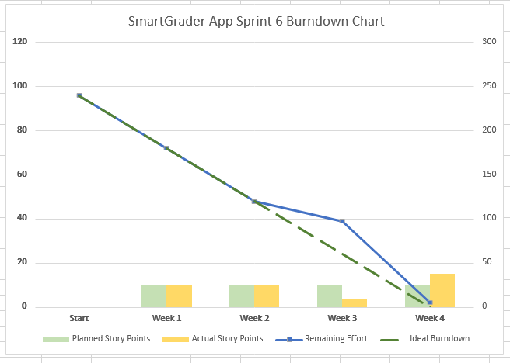
Burndown Chart
EMI HARRY

Slide 12

ACCEPTANCE CRITERIA

Slide 13
KEY​ | SUMMARY​ | LABEL​
Key-11 | 1.Given that the user is an educator, they must be able to navigate to the English tab in the subject's menu. | Input page
Key-26 | 1.Given that the user is an educator, they must be able to insert English questions for the assignment. | Input page
Key-27 | 1.Given that the user is an educator, they must be able to delete the English questions for the assignment. | Input page
Key-28 | 1.Given that the user is an educator, they must be able to see the English text for which they would be able to create questions for the assignment. | Input page
TJ RABBANI

Slide 14

Test cases

Slide 15
TEST CASES ​ FOR​​ | KEY​ | TEST CASES​​ | TEST DATA​ | EXPECTED RESULTS​​ | ACTUAL RESULT​ | Pass/Fail​​
Input Page | Key-11 | Subject button | Users in the educator account should be able to navigate to the English tab in the subject's menu. | Every user in the educator profile should be able to access the English subject tab. | Educators can now navigate to the English tab in the subject's menu. | Pass​​
​Input page | Key-26 | Insert button | Users in the educator account should be able to insert English questions for the assignment. | Every user in the educator profile should be able to create English questions. | Educators can now create English questions for the assignments using "insert question" button. | Pass​​
TJ RABBANI

Slide 16
TEST CASES ​​FOR​​​ | KEY​​ | TEST CASES​​​ | TEST DATA​​ | EXPECTED RESULTS​​​ | ACTUAL RESULT​​ | Pass/Fail​​​
Input Page​ | Key-27 | Delete button | Users in the educator account should be able to delete English questions for the assignment. | Every user in the educator profile should be able to delete English questions. | Educators can now create English questions for the assignments using "delete question" button. | Pass​​​
​Input page​ | Key-28 | Show text button | Users in the educator account should be able to see the text for which they would be able to create English questions for the assignment.​ | Every user in the educator profile should be able to see the text to create English questions.​ ​ | Educators can now see the text in which they would create English questions using "show text" button. | Pass​​​
GIO ABOU JAOUDE

Slide 17
TEST ​ CASES ​​ FOR​​​ | KEY​​ | TEST CASES​​​ | TEST DATA​​ | EXPECTED RESULTS​​​ | ACTUAL RESULT​​ | Pass/Fail​​​
Input Page​ | Key-29 | Update text button | Users in the educator account should be able update the text for which they would be able to create the English questions. | Every user in the educator profile should be able to update the text to create English questions for the assignment. | Educators should now be able to update the text using "update text" button. | Fail
GIO ABOU JAOUDE

Slide 18

Product Backlog

Slide 19

SUMMARY OF THE ISSUE | ISSUE TYPE | PRIORITY | STATUS
Built backend functionality to update the text in educator account. | Task | Highest | In Progress
Adding student English routes for student account. | Task | High | In Progress
Student should be able navigate to the English tab under subject | Story | High | In Progress
Built student-English html. | Task | High | In Progress
Setup database tables for student account. | Task | High | In Progress
JOSEPH DOUGAL

Slide 20
SUMMARY OF THE ISSUE | ISSUE TYPE | PRIORITY | STATUS
Built backend functionality to insert answer for student account. | Task | Medium | In Progress
Built backend functionality to update answers for student account. | Task | Medium | In Progress
Built backend functionality to delete answers for student account. | Task | Medium | In Progress
JOSEPH DOUGAL

Slide 21

Milestone Timeline

Slide 22
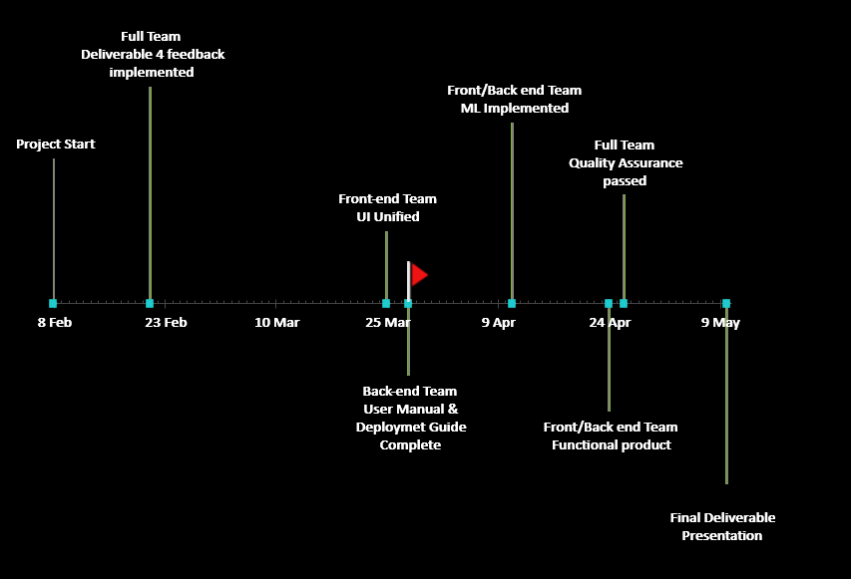
Sprint-6
Sprint-7
Sprint-8
Sprint-5
WAHIDUR RAHMAN

Slide 23

Retrospective
What went well:
Weekly team meetings
Team Dynamic
Team Communication
Presentation recording for deliverable 6 was done on time.
What needs to be improved:
Updates to Smart Grader needs to be done in a timely manner.
What's next:
Weekly updates should be provided about the application.
JOSE SALCEDO

Slide 24

Conclusion
FOR MORE DETAILS ON SMART GRADER VISIT OUR GITHUB REPOSITORY:
https://github.com/josephdougal/CS691/projects/1
JOSE SALCEDO

